Slide 1
Introduction to STL in C++
Vector, Pair, and Iterator
- A PRESENTATION BY ANANT AGARWAL

Slide 2
Vector Basics
A vector in C++ is a dynamic array that can grow and shrink in size. It is part of the <vector> header.
Basic Operations:
- Initialization
- Adding elements
- Accessing elements
- Iterating through elements

Slide 3
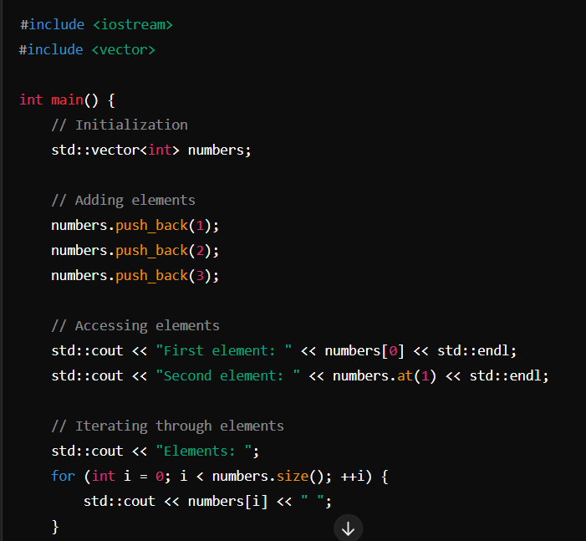
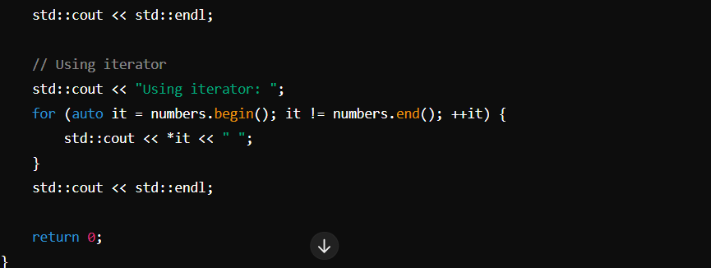
Vector Code Example

Slide 4
Pair Basics and Example
A pair is a simple container that stores two values. It is part of the <utility> header.
Basic Operations:
- Initialization
- Accessing elements

Slide 5
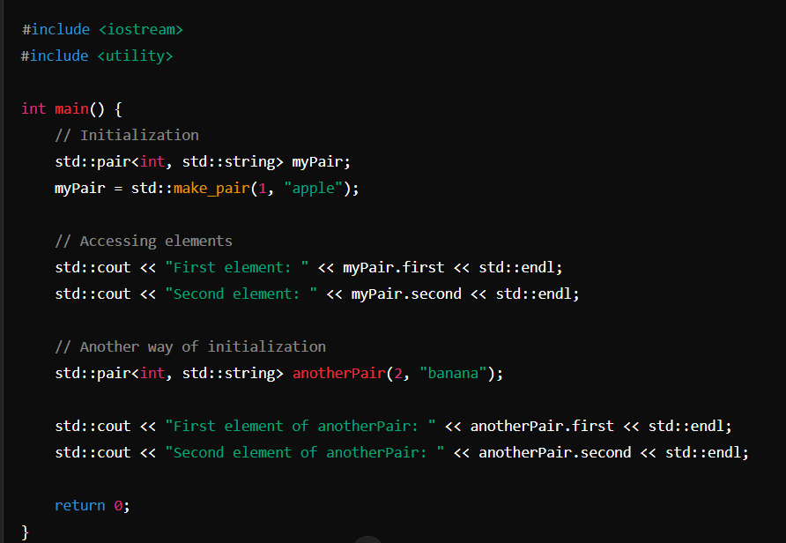
Code Example

Slide 6
Iterator Basics and Example
Iterators are objects that point to elements in containers like vector, map, etc. They are used to traverse through the elements of the container.
Basic Operations:
- Initialization
- Accessing elements
- Moving the iterator

Slide 7
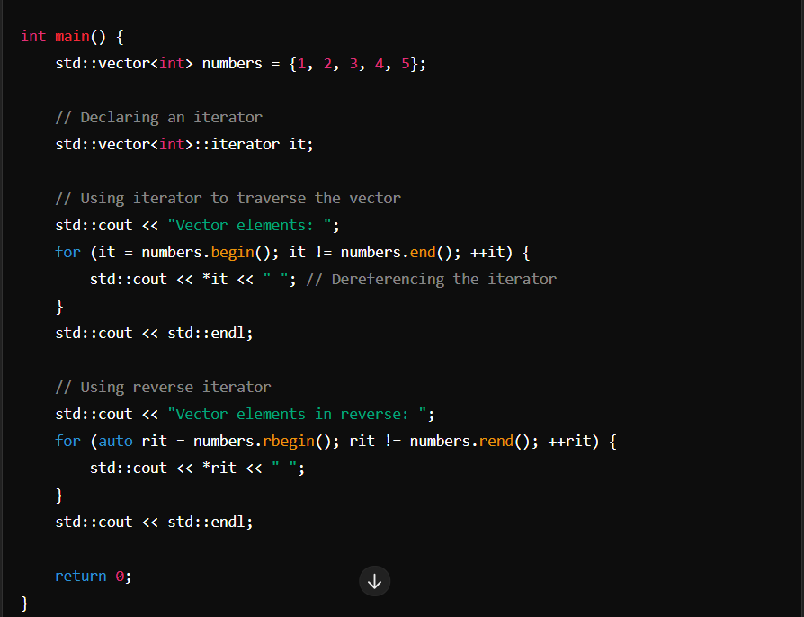
Code Example:

